Slide 1
loc & iloc
https://realpython.com/pandas-python-explore-dataset/

Slide 2
Using .loc and .iloc
The indexing operator ([ ]) is convenient, but there’s a caveat. What if the labels are also numbers? Say you have to work with a Series object like this:
>>> colors = pd.Series(
... ["red", "purple", "blue", "green", "yellow"],
... index=[1, 2, 3, 5, 8]
... )
>>> colors
1 red
2 purple
3 blue
5 green
8 yellow
dtype: object
What will colors[1] return? For a positional index, colors[1] is "purple". However, if you go by the label index, then colors[1] is referring to "red".
The good news is, you don’t have to figure it out! Instead, to avoid confusion, the Pandas Python library provides two data access methods:
1. .loc refers to the label index.
2. .iloc refers to the positional index.
These data access methods are much more readable:

Slide 3
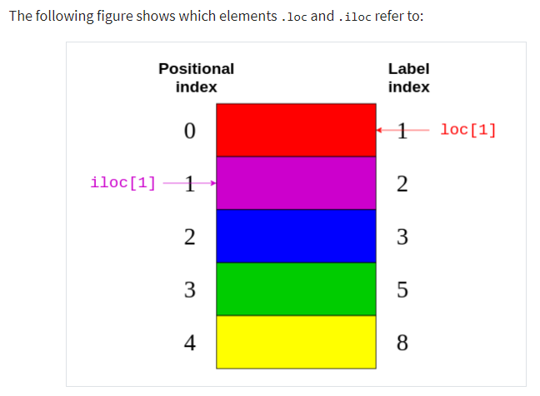
>>> colors.loc[1]
'red'
>>> colors.iloc[1]
'purple'
colors.loc[1] returned "red", the element with the label 1. colors.iloc[1] returned "purple", the element with the index 1.

Slide 4
